Slide 1
Maths project by AVANISH MURKUTE CLASS 6TH b ROLL NO. 12

Slide 2
Information about
aryabhata

Slide 3
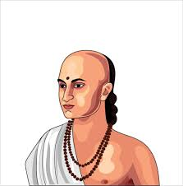
Facts ABOUT ARYABHATA
Born-476 AD, Pataliputra
Died-550 AD, Patalipurta
Era-Gupta era
Influenced-Lalla, Bhaskara I, Brahmaguta,Varahamihihira
Main interests-Mathematics,astronomy
Notable works-Aryabhata,Arya-siddhanta

Slide 4
Who is Aryabhata?
Aryabhata or Aryabhata I was the first of the major mathematician-astronomers from the classical age of Indian mathematics and Indian astronomy. His works include the Āryabhaṭīya and the Arya-siddhanta. For his explicit mention of the relativity of motion, he also qualifies as a major early physicist.

Slide 5
Why did Aryabhata invented 0(zero)?
George Ifrah, a French Mathematician stated that the concept and understanding of zero as a 'digit' was first given by Aryabhata in his place value system because the counting system of digits is not possible without the place value system or zero.

Slide 6
ARYABHATA BIRTH PLACE AND EDUCATION
It is believed that he completed his studies in Kusumapura. Aryabhata was the head of a Kusumapura institution (kulapa). Aryabhata was also the head of the Nalanda University, Bihar, because the university was located near Patliputra and housed an astronomical observatory.

Slide 7

WHAT ARE ACHIVEMENTS OF ARYABHATA?
Aryabhatta is the father of Indian Mathematics who significantly contributed to mathematics and astronomy and discovered theories like solar system rotation, approximation of pi, trigonometry, place value system and zero, and many other

Slide 8
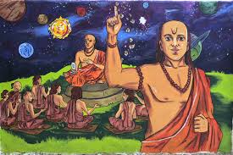
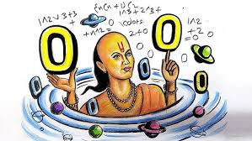
SOME PICTURES OF ARYABHATA
IMAGE1
IMAGE2

Slide 9
THANK YOU

